Slide 1
AI themes

Slide 2
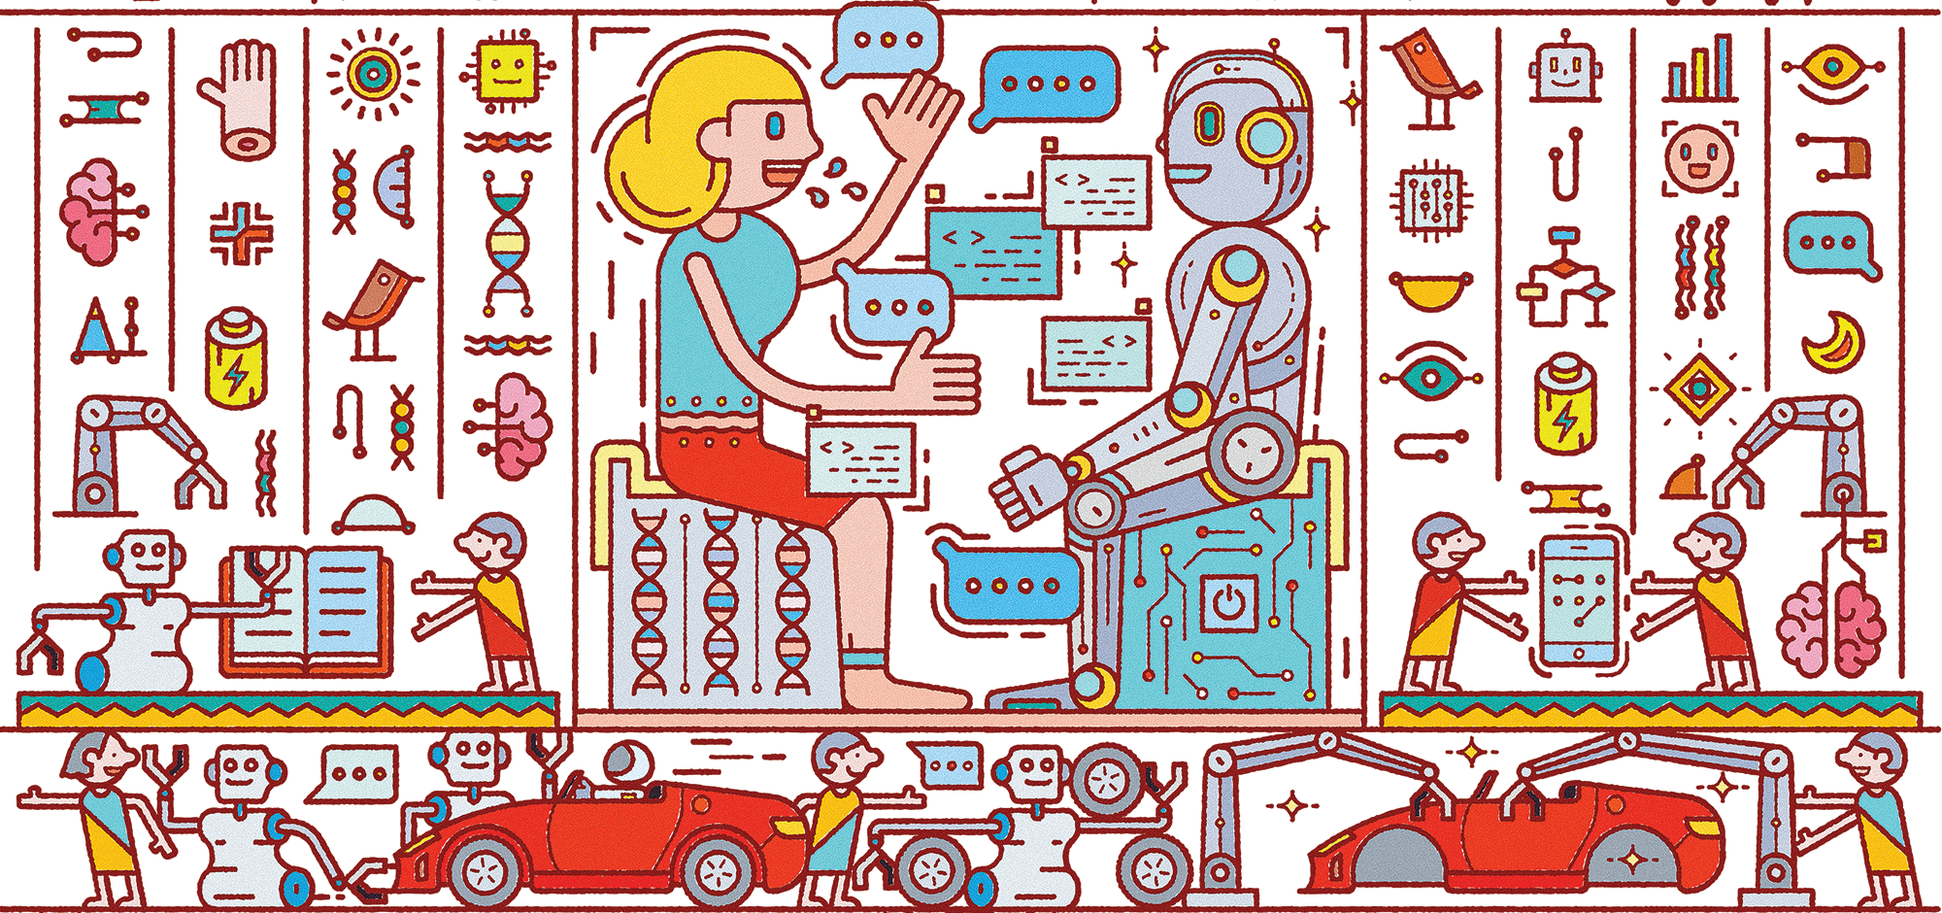
Human AI collaboration & interaction

Slide 3
Cont..
I believe people and machines should not be competitors, they should be collaborators,” Rus
"Most jobs will be partly affected by machine learning, but there will also be things humans need to do," Brynjolfsson

Slide 4
Why Human – AI have to team up ?
We can gain significant performance improvement when humans and AI work together
Through collaborative intelligence, humans and AI actively enhance each other’s complementary strengths
When the results are counterintuitive or controversial, human needs to assist the machines.
Artificial intelligence can boost humans analytic and decision-making abilities by providing the right information at the right time
Human-machine collaboration enables companies to interact with employees and customers in more effective ways.

Slide 5
AI Institute for Advances in Optimization
Advances in optimization should be developed to solve large-scale problems in domains such as resource allocation, planning, system design and optimization, and hardware and software design.
Advance optimization techniques should be able to solve the bias in real world problems.
Blending the themes, making small changes in the underlying core mathematical program that enable the develop of effective new algorithms.

Slide 6
AI and Advanced Cyberinfrastructure
AI accelerated simulations needs to be developed for accelerating the accuracy for use with ensembles of simulations.
Research is needed to provide more robust tools for data acquisition and preparation.
More advancements need to be developed for the scalability of deep learning training ie: GAN’s and deep reinforcement learning.
Increasing the system operation by spotting issues that negatively impact system performance, and optimizing queue structure.

Slide 7
Advances in AI and Computer and Network Systems
Need more advancements in the computer networking for detecting the events that are not obvious.
For accelerating the prediction of network feature (for instance, OS, device type, access point, or switch) that is most related to a network problem, accelerating problem resolution.
AI can be used for adjusting the network bandwidth for the application in use, by predicting the user’s internet performance

Slide 8
AI Institute in Dynamic Systems
AI helps to model a physical system for system control and calibration in a efficient way.
AI can be applied to design dynamic systems in living things like plants and animals with the help of neuron signals from the brain
AI can offer an alternative machine learning-based method for designing spontaneous behaviors by capitalizing on complex temporal patterns, like neural activities of animal brains.

Slide 9
AI augmented learning
AI could augment how teachers figure out the sentiments running deep in the class and spend more time addressing potential problem areas.
It can able to give more insightful learning to the students in a better way.
The correlative collaboration between AI and human can improve the quality of education.

Slide 10
AI to Advance Biology
Machines can able to see more in microscopic images than humans do.
Simulating the medicines rather than on humans reduces the risk of human life.
Can be used to monitor health continuously to prevent the human labor.

Slide 11
AI-Driven Innovation in Agriculture and the Food System
AI techniques have to be developed to focus on risk mitigation and resilience.
It can be applied to various problems like pest and disease prediction, yield calculation in farm and correct seasonal plantation.
AI can be used in food processing domain to analyse the flavour combination and consumer taste.

